Slide 1
Topic 5 Energetics & Thermochemistry

Slide 2
Energy and heat transfer energy
Energy is a measure of the ability to do work, that is to move an object against an opposing force.
It comes in many forms and includes heat, light, sound, electricity, nuclear energy and chemical energy – the energy released or absorbed during chemical reactions

Slide 3
Thermochemistry
Thermochemistry is the study of the energy (unit: joules, J, or kilojoules, kJ) and heat associated with chemical reactions and/or physical transformations. A reaction may release or absorb energy, and a phase change may do the same, such as in melting and boiling.

Slide 4
System and surroundings
Chemical and physical changes take place in many different environments such as test tubes, polystyrene cups, industrial plants and living cells.
System – the area of interest
Surroundings – in theory everything else in the universe
Most chemical reactions take place in an open system which can exchange energy and matter with the surroundings.
A closed system can exchange energy but not matter with the surroundings.
A isolated system can not exchange energy or matter with surroundings

Slide 5
The 1st Law of Thermodynamics
The law of Conservation of Energy: the total energy of an isolated system is constant; energy can be transformed from one form to another, but cannot be created or destroyed.
Energy can only be exchanged between a system and the surroundings, but the total energy cannot change during the process
Therefore, any energy lost by the system is gained by the surroundings and vice versa.

Slide 6
Enthalpy, H
Enthalpy, H (unit joules: J or kJ) is the total heat content of a system, some of which is stored as chemical potential energy in the chemical bonds.
Absolute H can not be measured, but the change ΔH can.
In chemistry reaction, bonds are broken and made, energy absorbed and released.
Enthalpy change of reaction ΔH (unit: kilojoules per mole, kJ/mol) equal to the difference in enthalpy between the reactions and the products.

Slide 7
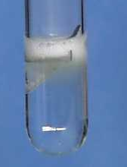
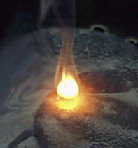
Exothermic Reactions
Exothermic reactions increase in temperature.
Examples include:
Combustion reactions including the combustion of fuels.
Detonation of explosives.
Reaction of acids with metals.
Neutralization
Magnesium reacting with acid
Combustion reaction

Slide 8
Exothermic Reactions
Magnesium + Hydrochloric acid
25º C
45º C
magnesium
Heat
energy
given
out
Gets hot
Hydrochloric
acid

Slide 9
Exothermic Reactions
If heat is given out from the system to the surrounding, this energy must have come from chemical energy in the starting materials (reactants).
45º C
25º C
Reactants convert chemical energy to heat energy.
The temperature rises.

Slide 10
Energy Level Diagram for an
Exothermic Reaction
Reactants have more chemical energy.
reactants
Some of this is lost as heat which spreads out into the room.
Energy / kJ)
Products now have less chemical energy than reactants.
products
Progress of reaction (time)

Slide 11
Energy Level Diagram for an
Exothermic Reaction 2.
Energy Level Diagram for an
Exothermic Reaction
ΔH is how
much energy
is given out
reactants
ΔH is negative
because the products have less energy than the reactants.
ΔH=negative
Energy / kJ
products
Progress of reaction

Slide 12
Exothermic Reaction - Definition
Exothermic reactions give out energy. There is a temperature rise and ΔH is negative.
reactants
Energy / kJ)
ΔH is negative
products
Progress of reaction

Slide 13
Activity
Say whether these processes are exothermic.
Charcoal burning
A candle burning.
A kettle boiling
Ice melting
A firework exploding
yes
yes
no
no
yes
You have to put heat in for boiling and melting.
You get heat out from all the other processes

Slide 14
Endothermic Reactions
Endothermic reactions cause a decrease in temperature.
25º C
5º C
Ammonium
nitrate
Cools
Water
Starts 25°C
Cools to 5°C

Slide 15
Endothermic Reactions
Extra energy is needed in order for endothermic reactions to occur.
This comes from the thermal energy of the reaction mixture which consequently gets colder.
5º C
25º C
Reactants convert heat energy into chemical energy as they change into products. The temperature drops.

Slide 16
Energy Level Diagram for an
Endothermic Process
This is how
much energy
is taken in
products
This is positive
because the products have more energy than the reactants.
ΔH=+
Energy / kJ)
reactants
Progress of reaction

Slide 17
Endothermic Reaction Definition
Endothermic reactions take in energy. There is a temperature drop and ΔH is positive.
products
ΔH=+
Energy / kJ
reactants
Progress of reaction

Slide 18

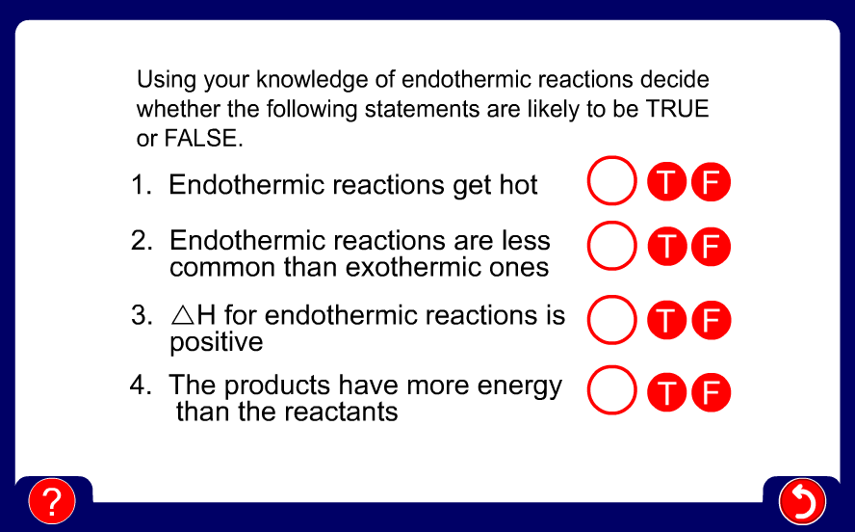

Slide 19
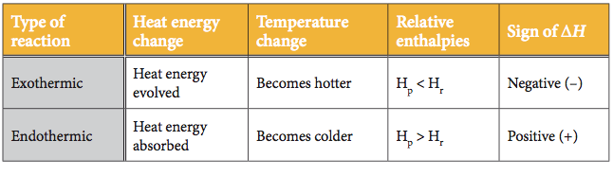
Exo V.S. Endo

Slide 20
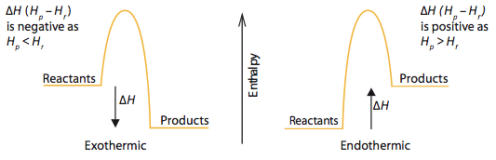
Exothermic V.S. Endothermic

Slide 21
Activity
Are these endothermic or exothermic?
A red glow spread throughout the mixture and the temperature rose.
The mixture bubbled vigorously but the temperature dropped 15⁰C.
Hydrazine and hydrogen peroxide react so explosively and powerfully that they are used to power rockets into space.
The decaying grass in the compost maker was considerably above the outside temperature.
exo
endo
exo
exo

Slide 22
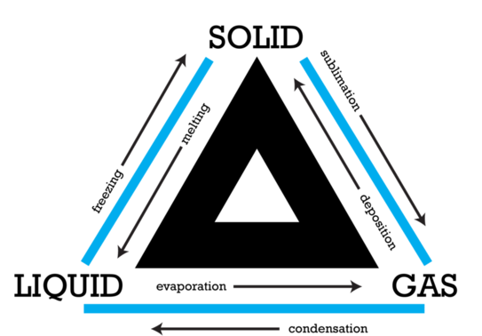

Slide 23
Thermochemical standard conditions
It is defined as a temperature of 25 °C (298K),
a pressure of 100 kPa with all solutions having a concentration of 1 mol/L.
Different from standard temperature and pressure (S.T.P.) for gases
Use “θ”, a ‘standard’ sign as superscript to indicate: ΔH^{θ}

Slide 24
Thermochemical Equations
The combustion of methane can be described by the thermochemical equation:
CH₄ (g) + 2 O₂ (g) → CO₂ (g) + 2 H₂O (l) ΔH^{θ} = -890kJ mol⁻¹
This is a shorthand way of expressing information that one mole of methane gas reacts with two moles of oxygen gas to give one mole of gaseous carbon dioxide and two moles of liquid water and releases 890 kJ of heat energy.
For exothermic reaction the enthalpy change should be always negative since the system loses some energy.

Slide 25
The thermochemical equation for photosynthesis can be represented as:
6 CO₂ (g) + 6 H₂O (l) → C₆H₁₂O₆ (aq) + 6 O₂ (g)
ΔH^{θ} = +2802.5 kJ mol^{–1}
which means that 2802.5 kJ of energy is absorbed when one mole of aqueous glucose is formed under standard conditions from gaseous carbon dioxide and liquid water.
The enthalpy change of an endothermic reaction should always be positive since the system gains some energy.

Slide 26
Temperature is a measure of average kinetic energy
The movement or kinetic energy of the particles of a substance depends on the temperature.
If the temperature of a substance is decreased, the average kinetic energy of the particles also decreases.
Absolute zero (–273°C) is the lowest possible temperature attainable as this is the temperature at which all movement has stopped.
The absolute temperature, measured in Kelvin, is directly proportional to the average kinetic energy of its particles.

Slide 27
Heat changes can be calculated from temperature changes
In general, the increase in temperature when an object is heated depends on:
The mass of the object
The heat added
The nature of the substance (specific heat capacity)
The specific heat capacity is the property of a substance which gives the heat needed to increase the temperature of unit mass by 1 K.
heat change (q) = mass (m) × specific heat capacity (c) × temperature change (ΔT)

Slide 28
Energy required (Q) =
mass heated (m)
x
energy needed to make 1 g of substance 1ºC hotter
x
temperature rise (∆T)

Slide 29
Energy required (Q) =
mass heated (m)
x
x
temperature rise (∆T)
specifc heat capacity (c)

Slide 30
Heat energy: Q = m c ∆T
J g (J K⁻¹ g⁻¹) K

Slide 32
Measuring enthalpy changes of combustion

Slide 33
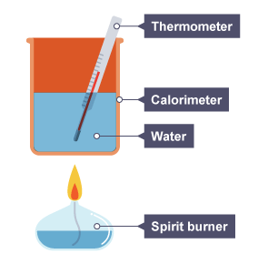
Calorimetry method
Cold water is measured into a copper calorimeter (a small metal can).
The starting temperature of the water is recorded.
The water is heated using the flame from the burning fuel.
The final temperature of the water is recorded.
The spirit burner containing the fuel is usually weighed before and after the experiment so that the mass of the fuel burned can be found.
Q ethanol+ Q water = 0
Q water = m c ∆T = m c (T final - initial)
Q ethanol = - Q water
∆H = - Q water/n (ethanol)

Slide 34
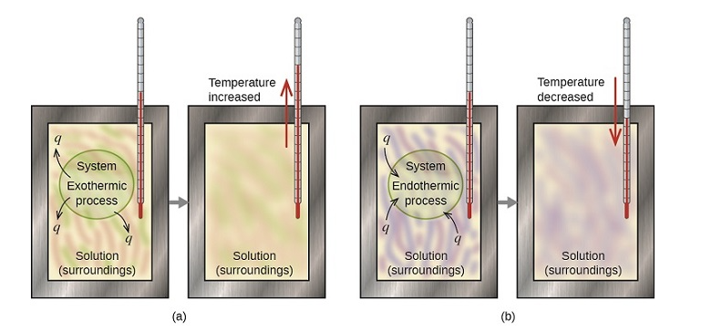
Calorimetry
Is the technique used to measure the change of enthalpy associated with a particular reaction/process. The temperature change of a liquid inside a well insulated container, known as a calorimeter, is measured before and after the change.
(a) an exothermic process occurs and heat, q, is negative, indicating that thermal energy is transferred from the system to its surroundings
(b) an endothermic process occurs and heat, q, is positive, indicating that thermal energy is transferred from the surroundings to the system.
Temperature increase/decrease → Temperature of environment
T ↑ system release energy to environment ( exo reaction/process for system)
T ↓ system absorb energy to environment ( endo reaction/process for system)

Slide 35
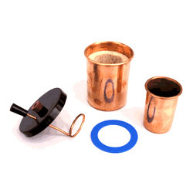
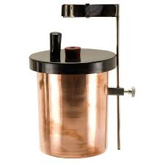
Copper calorimeter --- for combustion reactions

Slide 36
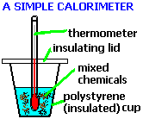
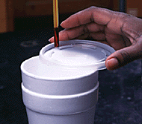
A convenient calorimeter---Styrofoam cup
Reason: it has low heat capacity (negligible)
And is a good insulator.

Slide 37
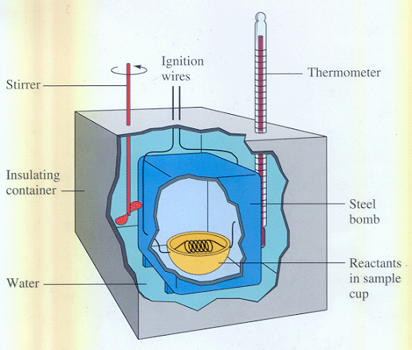
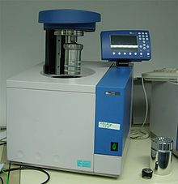
Bomb calorimeter --- to minimize the heat lost

Slide 38
Calorimetry depends on the assumption that all the heat absorbed or evolved only changes the temperature of the calorimeter and its contents, no heat is gained from or lost to the surroundings.
Insulation is important~!!
Major source of error of calorimetry in school labs is heat exchange with the surroundings

Slide 39
Calculating enthalpy changes of reaction from temperature changes
When the heat released by an exothermic reaction is absorbed by water, the temperature of the water increases. The heat produced by the reaction can be calculated if it is assumed that all the heat is absorbed by the water.
Q reaction+ Q water = 0
q_{reaction}= - q_{water}= - m_{(H2O)} × c_{(H2O)} × ΔT_{(H2O)}
= - m_{(H2O)} × c_{(H2O)} × (T_{final} –T _{initial})
_{Conservation of energy}

Slide 40
Practice
Calculate the enthalpy of combustion of ethanol from the following data. Assume all the heat from the reaction is absorbed by the water. Compare your value with the IB data booklet value and suggest reasons for any differences.

Slide 41
q_{reaction}

Slide 42
The IB data booklet value is –1367 kJ mol^{–1}. The difference between the values can be accounted for by any of the following factors:
Not all the heat produced by the combustion reaction is transferred to the water. Some is needed to heat the copper calorimeter and some has passed to the surroundings.
The combustion of the ethanol is unlikely to be complete owing to the limited oxygen available, as assumed by the literature value.
The experiment was not performed under standard conditions.

Slide 43
Enthalpy changes of reaction in solution
The enthalpy changes of reaction in solution can be calculated by carrying out the reaction in an insulated system, for example, a polystyrene cup.
The heat released or absorbed by the reaction can be measured from the temperature change of the water.

Slide 44
Assumptions to be made
No heat loss from the system
All the heat goes between the reaction and the water [The heat energy required to change the temperature of the other substances present may be ignored, in comparison to that needed to heat the water (usually in excess and has a very high specific heat capacity)]
The solution is dilute: V(solution) = V(H₂O)
Solution has the same density as water: 1.00 g cm^{–3}.
Solution has the same specific heat capacity as water: 4.18 J g⁻¹ K⁻¹
So: q_{water} + q_{reaction} =0
q_{reaction} = – q_{water}

Slide 45
For an exothermic reaction, q_{reaction} is negative as heat has passed from the reaction into the water.
q_{water} = m(H₂O) × c(H₂O) × ΔT(H₂O)
The limiting reactant must be identified in order to determine the molar enthalpy change of reaction.

Slide 46
Getting the maximum temperature from experiment considering the heat loss to surrounding
A known volume of copper sulfate solution is added to the calorimeter and its temperature measured every 25 s.
Excess zinc powder is added after 100 s and the temperature starts to rise until a maximum after which it falls in an approximately linear fashion.

Slide 47
Heat is lost from the system as soon as the temperature rises above the temperature of the surroundings, in this case 20 °C.
We can make some allowance for heat loss by extrapolating the cooling section of the graph to the time when the reaction started (100 s).

Slide 50
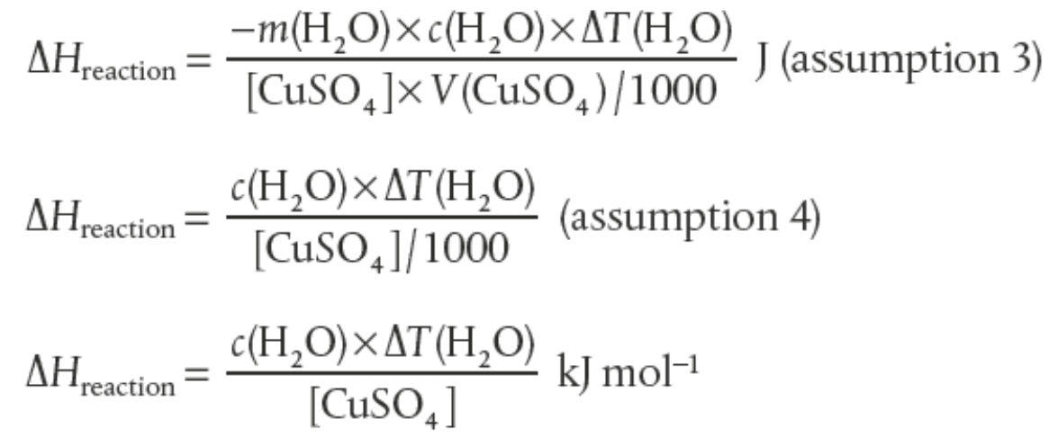
-
-

Slide 51
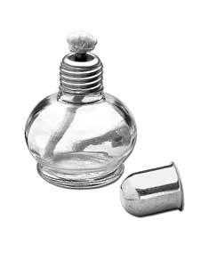
2 moles of ethanol burned
Energy given out =
2734 kJ
Energy given out by 1 mole =
2734 kJ
2
= 1367 kJ
∆H =
–1367 kJ mol⁻¹

Slide 52
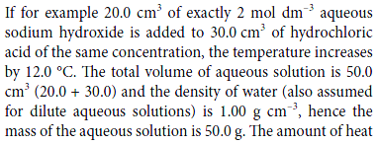
Practice:
Q= ?
∆H=?

Slide 53
Practice:
3.53 g of sodium hydrogen carbonate was added to 30.0 cm³ of 2.0 mol dm⁻³ hydrochloric acid. The temperature fell by 10.3 K. (Assume that the density of the solution is 1.00 g cm⁻³, the specific heat capacity of the solution is 4.18 J g⁻¹ K⁻¹.)
Q= ?
∆H=?

Slide 54
3.53 g of sodium hydrogen carbonate was added to 30.0 cm³ of 2.0 mol dm⁻³ hydrochloric acid. The temperature fell by 10.3 K. Work out which reagent was in excess and then calculate the enthalpy change for the reaction. Assume that the density of the solution is 1.00 g cm⁻³, the specific heat capacity of the solution is 4.18 J g⁻¹ K⁻¹.
Q = mc∆T
m = 30
c = 4.18
∆T = 10.3
Q = 30 x 4.18 x 10.3 = 1292 J
∆H = Q / n
n_{HCl} = c V
= 2.0 x ³⁰/₁₀₀₀ = 0.060 mol
n_{NaHCO3} = m / M_{r}
= 3.53 / 84.0 = 0.0420 mol
HCl + NaHCO₃ → NaCl + H₂O + CO₂
∆H = Q/n = 1.292 / 0.0420
= +30.8 kJ mol⁻¹

Slide 55
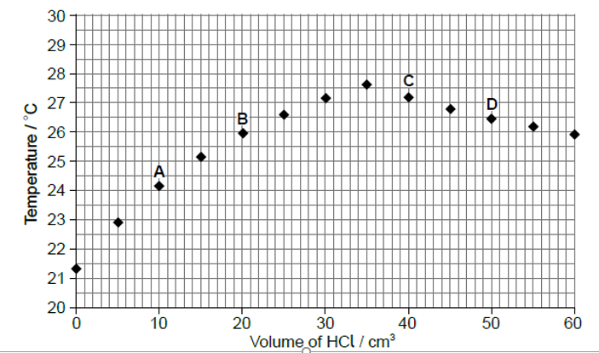
Titration without indicator but with temperature probe
C_{NaOH}V_{NaOH}=C_{(?)}V _{HCl}
V _{HCl} = 32~33 ml
Q = cm ΔT =c m (T_{final} –T _{initial}) = c m (27.8-21.3)

Slide 56
5.2 Hess’s Law

Slide 57
Conservation of energy states that energy cannot be created or destroyed.
In chemistry, it means that the total change in chemical potential energy (∆ H) must be equal to the energy lost or gained by the system.
It also means that the total enthalpy change on converting a given set of reactants to a particular set of products is constant, irrespective of the way in which the change is carried out.-----Hess’s Law

Slide 58
Reaction 1: A + B C+D ∆H₁
Reaction 2: 2A E+D ∆H₂
Reaction 3: E +2B 2C+D ∆H₃
What the relation between three reactions?

Slide 59
Reaction 1: A + B C+D ∆H₁
Reaction 2: 2A E+D ∆H₂
Reaction 3: E +2B 2C+D ∆H₃
What the relation between three reactions?
2 × Reaction 1 = Reaction 2 + Reaction 3
2 ∆H₁ = ∆H₂ + ∆H₃

Slide 60




Reaction 1:
Reaction 2:
Reaction 3:

Slide 61
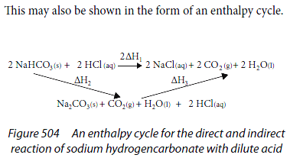

Slide 62

= -140kJ/mol
= ?
= -370kJ/mol

Slide 63

= -140kJ/mol
= ?
= -370kJ/mol

Slide 64
Practice 1:
①
②
① - ②

Slide 65
Practice 2:

Slide 66
Practice 3:

Slide 68
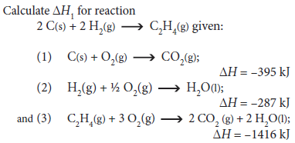
Practice 4:
/mol
/mol
/mol

Slide 69
Practice 5:
2B (s) + (3/2) O₂ (g) → B₂O₃ (s) ΔH = ?
B₂H₆ (g) + 3O₂ (g) → B₂O₃ (s) + 3H₂O (g) ΔH₁ = -2035 kJ/mol
H₂O (l) → H₂O (g) ΔH₂ = 44 kJ/mol
H₂O (l) → H₂ (g) + (1/2) O₂ (g) ΔH₃ = 286 kJ/mol
2B (s) + 3H₂ (g) → B₂H₆ (g) ΔH₄ = 36 kJ/mol

Slide 70
Practice 6:
Cl₂(g) → 2 Cl(g) ΔH⬇ = + 242 kJ mol⁻¹
H₂(g) → 2 H(g) ΔH⬇ = + 436 kJ mol⁻¹
HCl(g) → H(g) + Cl(g) ΔH⬇ = + 431 kJ mol⁻¹
H₂(g) + ½ O₂(g) → H₂O(g) ΔH⬇ = - 242 kJ mol⁻¹
O₂(g) → 2 O(g) ΔH⬇ = + 496 kJ mol⁻¹
Using above data to calculate the enthalpy change for the following reaction:
H₂(g) + Cl₂(g) → 2 HCl(g)

Slide 71
Standard Enthalpy Change of Reaction
The enthalpy change of a reaction depends on the physical state of the reactants and the products and the conditions under which the reaction occurs.
For this reason, standard enthalpy changes, ΔH^{θ},which are measured under standard conditions of 298 K (25 °C) and 1.00 × 10⁵ Pa (100 kPa), are generally tabulated.

Slide 72
Standard Enthalpy Change of Combustion
The standard enthalpy change of combustion, ΔH_{c} ^{θ} , of a substance is the enthalpy change for the complete combustion of ONE MOLE of a substance in its standard state in excess oxygen under standard conditions (298 K, 1.00×10⁵ Pa).

Slide 73
Standard Enthalpy Change of Formation
The standard enthalpy change of formation, ΔH_{f} ^{θ} , of a substance is the enthalpy change that occurs when one mole of the substance is formed from its elements in their standard states.
These standard measurements are taken at a temperature of 298 K (25 °C) and a pressure of 1.00 × 10⁵ Pa (100 kPa).
They are important as they:
give a measure of the stability of a substance relative to its elements
can be used to calculate the enthalpy changes of all reactions, either hypothetical or real.

Slide 75



Using standard enthalpy changes of formation
Standard enthalpy changes of formation can be used to calculate the standard enthalpy change of any reaction.

Slide 77
Practice 1:

Slide 79
Practice 3:

Slide 83
Practice 4:
c
c

Slide 84
Practice 5:
Combustion enthalpy
of 1-propanol:-2021kj/mol
Combustion enthalpy
of 2-propanol:-2006kj/mol

